Slide 1
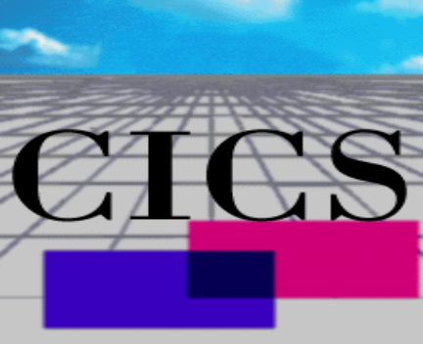




IBM TXSeries(CICS)

Slide 2

The Big Picture: Transactional Middleware
Transactional middleware does three things extremely well...
  Client connection management
  Transaction management
  Resource management
Clients
Transactional
Resources
Middleware
The middle-tier promotes scale and performance and also supports logical segmentation based on presentation, logic, and data.

Slide 3
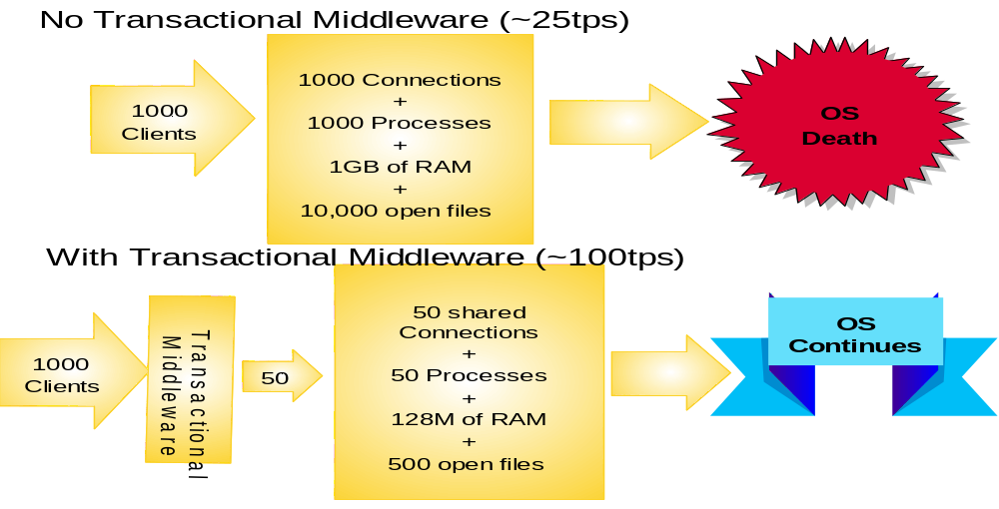
Resource and Connection Management

Slide 4
Managing Transactions
Business processing typically requires acess to
multiple
resources
.
If these resources must be changed, how do you
coordinate updates, and how do you guarantee
consistency?
With a distributed transaction monitor!
Does your customer understand how
critical this is to enterprise integrity?

Slide 5

What is CICS?
CICS - Customer Information Control System
CICS was originally created to provide online transaction processing for the System/360 MVS Systems
MVS was primarily oriented to "batch" applications and there was a need to consolidate functions required to on-line applications
  Terminal control
  Application execution
  Common system services
  Transaction control

Slide 6

IBM TXSeries(CICS)的历史
1969年IBM CICS 第一版发布
1993年IBM推出了UNIX平台的CICS产品
1998年IBM发布了TXSeries(CICS)系列产品

Slide 7
IBM TXSeries(CICS)业界领导
Fortune 100家公司中99家信任并使用着... IBM TXSeries市 场 占 有 率
(1998 年 12 月 Forrester Research)

Slide 8

IBM TXSeries(CICS) 家族
TXSeries for WinNT
TXSeries for Aix
TXSeries for Sun Solaris
TXSeries for HP-UX
CICS for OS/400
CICS for VSE
CICS for MVS
CICS for OS/390

Slide 9

IBM TXSeries 包装
CICS v4.3
Encina v4.3
CICS Clients
DCE Cell Directory Server and Security Server V3.1
MQSeries v5.1

Slide 10

WebSphere Application Server
IBM WebSphere应用服务器，高级版，版本3.5
IBM组件代理程序，版本3.5(服务器)
IBM TXSeries 版本4.3
IBM CICS事务处理网关，版本3.0.2
IBM CICS通用客户机，版本3.1
IBM MQSeries，版本5.1
用于AIX的IBM DCE，版本3.1
用于Windows NT的IBM DCE，版本2.2
用于Solaris的IBM/Transarc，版本2.0

Slide 11
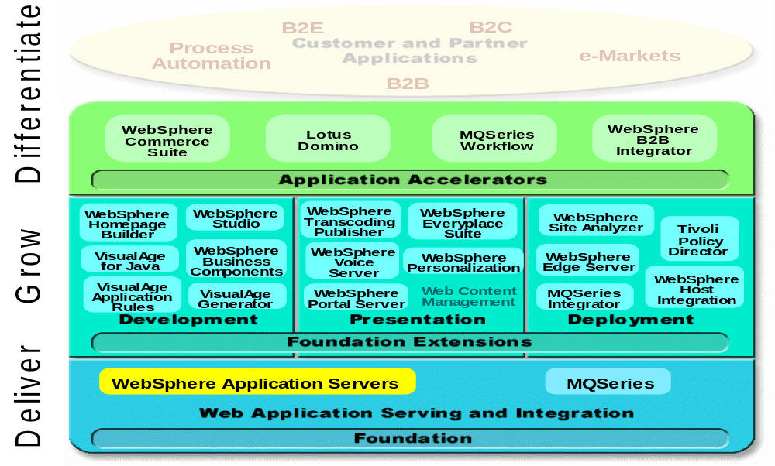
The WebSphere Software Platform

Slide 12
IBM TXSeries 典型架构
RDB
Web Browser
Region1
SFS
Transaction Request Accepted
Region2
GUI/TUI
Region3
VSAM
Remote Region
CICS Server
CICS

Slide 13
TXSeries Server 层次结构
应用程序
Encina Monitor
CICS Monitor
Encina SFS & PPC Services
Encina Executive and Server
Distributed Computing Environment
操作系统
Unix、WinNT...
硬件
RISC、Intel...

Slide 14
TXSeries Server 层次结构
应用程序
Transaction Monitors
Administration
Authorization
Performance Optimization
Transaction Scheduling Exception Handling Time Control
分布式应用服务
Forms Mgt. Queue Mgt. Data Mgt. Connectivity
分布式交易服务
Two-Phase Commit Recovery Logging Locking
分布式计算服务
通讯 网络命名 安全服务 线程支持
操作系统
Unix、WinNT...
硬件
RISC、Intel...

Slide 15

CICS与DCE 服务
CICS使用的DCE服务：
  远程过程调用（RPC）
  单元目录服务（CDS）
  安全服务（SS）
  线程支持（TS）

Slide 16

CICS与Encina
CICS使用Encina OLTP Toolkit提供的服务
内部使用的服务程序：
  客户日志服务
  XA数据库支持
  交易管理
  交易RPC
  端到端执行
外部使用的服务程序：
  结构化文件服务程序
  端到端网关

Slide 17
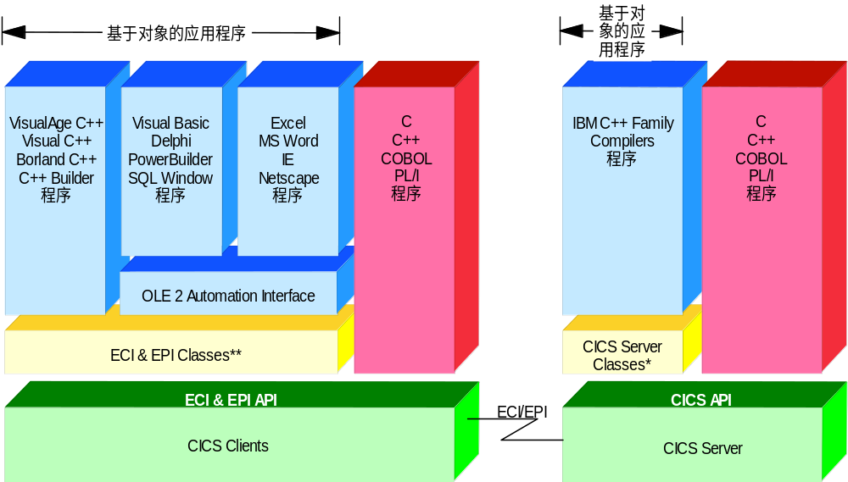
(传统/面向对象) CICS应用开发

Slide 18

CICS Client 编程
功能
  从非CICS程序的客户程序调用CICS Server交易
方式
  External Call Interface，简称ECI
  External Presentation Interface，简称EPI

Slide 19
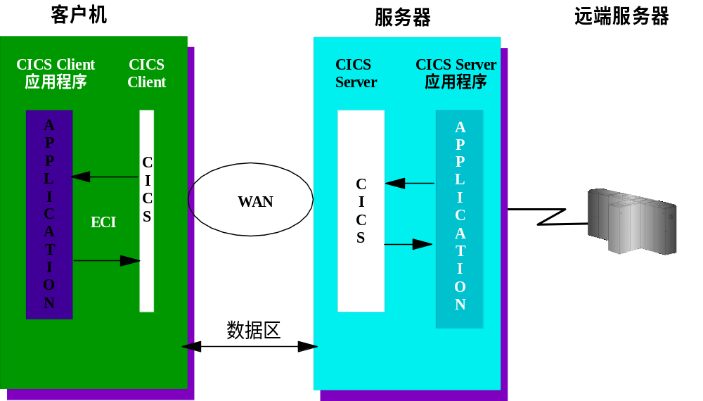
External Call Interface (ECI)

Slide 20

External Presentation Interface

Slide 21
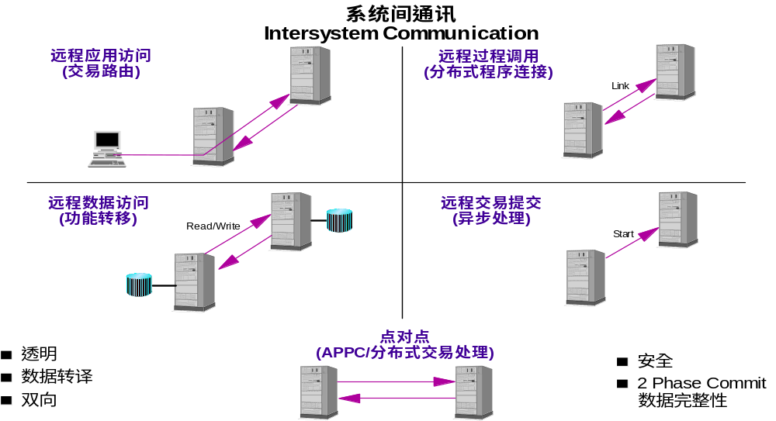
CICS系统间通讯(ISC)

Slide 22

IBM TXSeries(CICS) 资源
News Groups
  news.software.ibm.com/
  ibm.software.websphere.application-server
OO AD Certification:
  www.ibm.com/software/ad/certify
Training
  IBM Learning Services:
    www.training.ibm.com/ibmedu
  Redbooks:
    www.redbooks.ibm.com

Slide 23


IBM TXSeries(CICS)

